Slide 1

Algebra 1
Unit 9, Lesson 7 Solving Quadratics by Factoring Volume 2, pg. 93

Slide 2


Benchmark
MA.912.AR.3.1
Given a mathematical or real-world context, write and solve one-variable quadratic equations over the real number system.
volume 2, pg. 93

Slide 3
Integrated Mathematical Thinking and Reasoning Standards
MA.K12.MTR.1.1 Actively participate in effortful learning both individually and collectively.
MA.K12.MTR.2.1 Demonstrate understanding by representing problems in multiple ways.
MA.K12.MTR.3.1 Complete tasks with mathematical fluency.
MA.K12.MTR.4.1 Engage in discussions that reflect on the mathematical thinking of self and others.
MA.K12.MTR.6.1 Assess the reasonableness of solutions.
volume 2, pg. 93

Slide 4

Learning Target
I can solve a quadratic by factoring.
volume 2, pg. 93

Slide 5

Warm-Up
volume 2, pg. 94

Slide 6
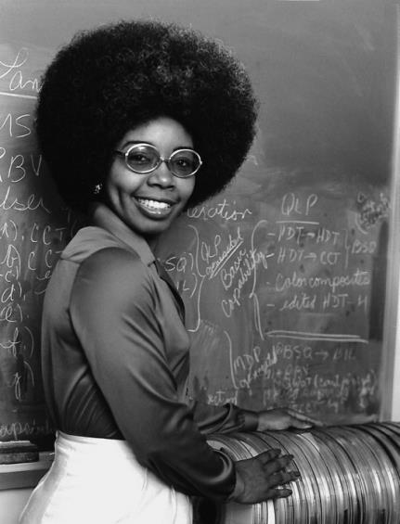
9.7.1 Warm-Up: Satellite Dishes
Valerie Thomas is a scientist and inventor. In 1980, she received a patent for inventing the illusion transmitter. This was an integral piece of technology in developing the digital media formats needed for today’s video games, movies, and 3D television.
Thomas worked at NASA from 1964‑1995, where she helped develop real-time computer data systems to support satellite operations. She oversaw the creation of the Landsat program there, which supported the first satellite to transmit images from outer space.
volume 2, pg. 94
Notes:
Video Link: https://algebranation.wistia.com/medias/fi4fidi5y8

Slide 7
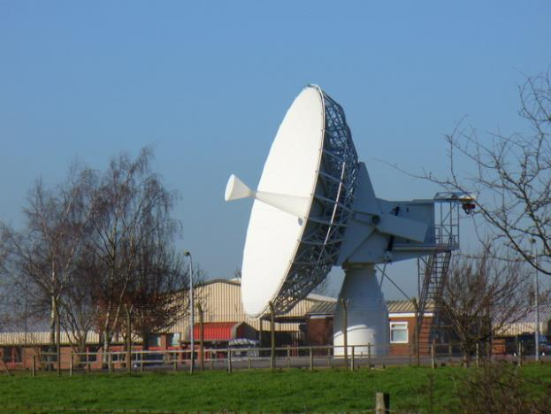
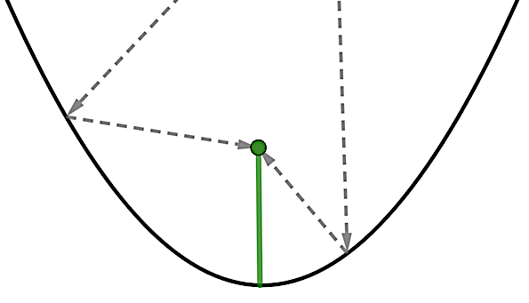
Today, satellite dishes are everywhere. Satellite dishes are designed using a parabolic curve.
What key feature of a parabola is the bottom of the dish?
The arrows show how signals bounce off a satellite dish to the receiver. The receiver is always located at a parabola’s focus. What key feature does the focus lie on?
volume 2, pg. 94

Slide 8

Activity
volume 2, pg. 94

Slide 9

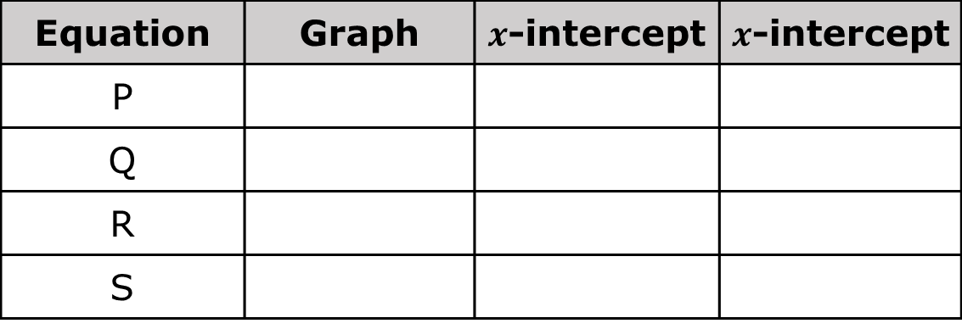
9.7.2 Activity: Card Sort
Work with your partner to match the cards.
Equation | Graph | $x$-intercept | $x$-intercept
P
Q
R
S
volume 2, pg. 94

Slide 10
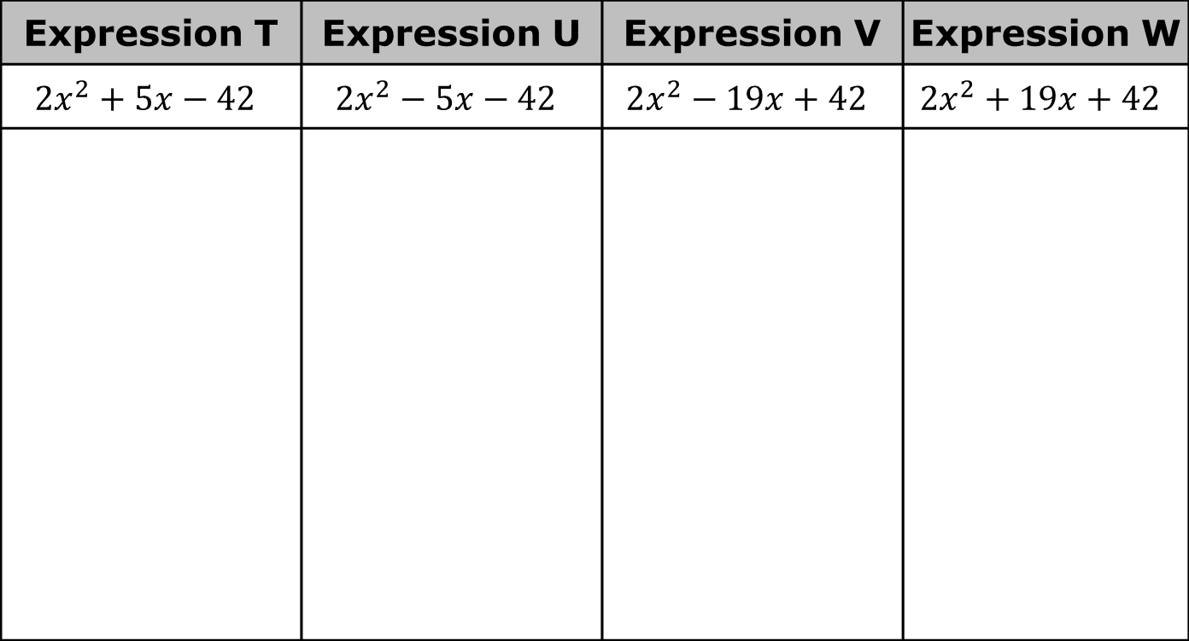
Factor each expression.
Expression T | Expression U | Expression V | Expression W
$$2x^{2}+5x−42$$ | $$2x^{2}−5x−42$$ | $$2x^{2}−19x+42$$ | $$2x^{2}+19x+42$$
volume 2, pg. 94

Slide 11
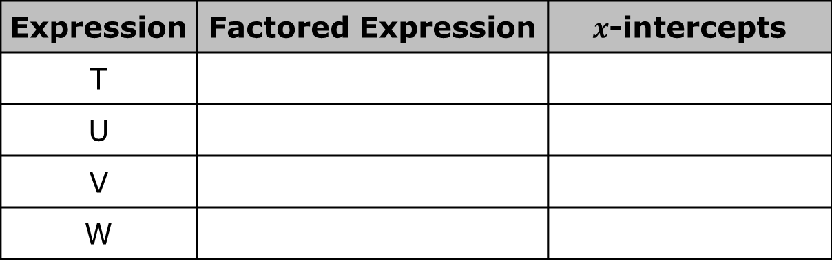
Work with your partner to match the factored expressions to the 𝑥-intercepts.
Discuss with your partner how the factored expression reveals the 𝑥-intercepts. Make a conjecture about the connection.
Expression | Factored Expression | $x$-intercepts
T
U
V
W
volume 2, pg. 95

Slide 12

Guided Instruction
volume 2, pg. 95

Slide 13

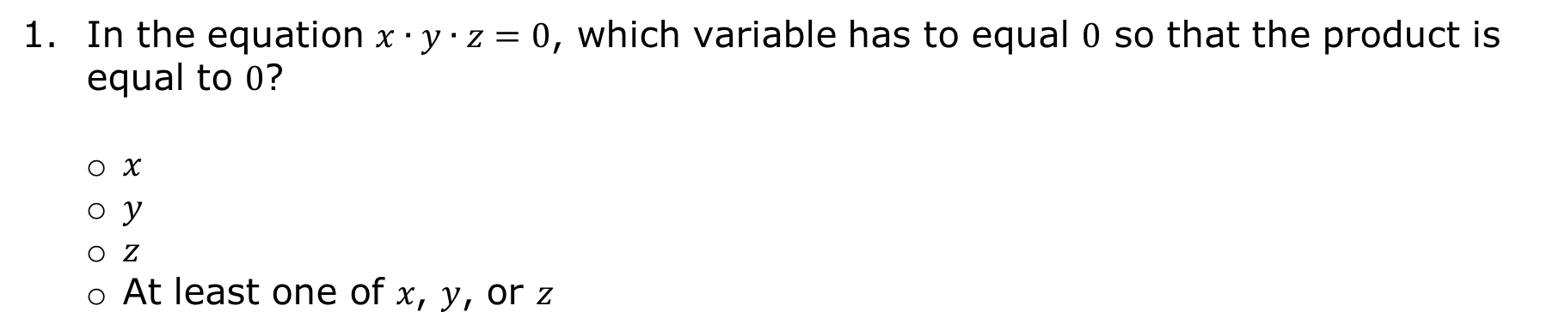
9.7.3 Guided Instruction: Solving Quadratic Equations by Factoring
In the equation $x∙y∙z=0$, which variable has to equal $0$ so that the product is equal to $0$?
𝑥
𝑦
𝑧
At least one of 𝑥, 𝑦, or 𝑧
Zero Product Property
If the product of two numbers is 0, then at least one of the numbers is 0.
volume 2, pg. 95

Slide 14

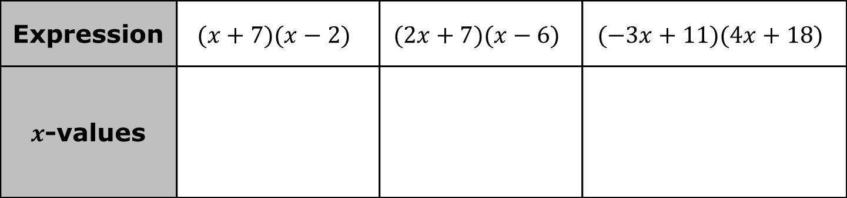
For each expression, use the zero product property to determine the values of 𝑥 for which the expression would equal $0$.
Each of these expressions could have been written as quadratic equations that are set equal to 0 such as $x^{2}+5x−14=0$.
Expression | $$(x+7)(x−2)$$ | $$(2x+7)(x−6)$$ | $$(−3x+11)(4x+18)$$
$x$-values
volume 2, pg. 95

Slide 15
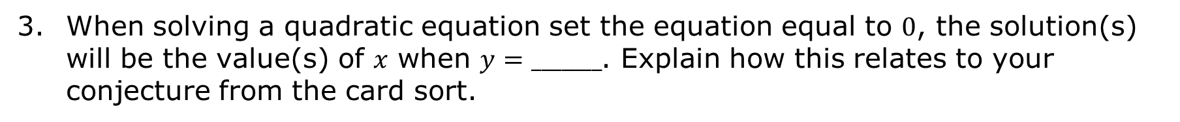
When solving a quadratic equation set the equation equal to $0$, the solution(s) will be the value(s) of 𝑥 when $y=_______$. Explain how this relates to your conjecture from the card sort.
volume 2, pg. 96

Slide 16
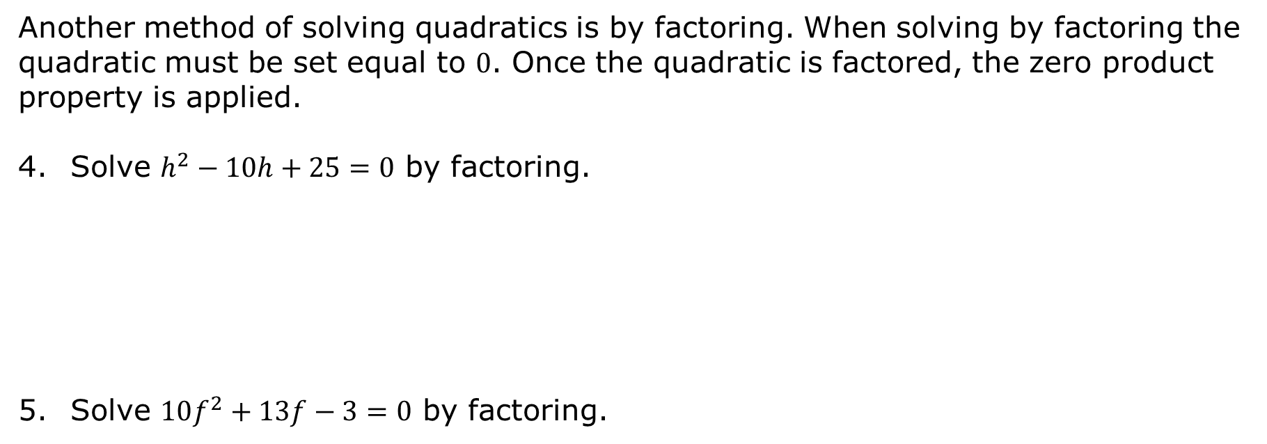
Another method of solving quadratics is by factoring. When solving by factoring the quadratic must be set equal to $0$. Once the quadratic is factored, the zero product property is applied.
Solve $h^{2}−10h+25=0$ by factoring.
Solve $10f^{2}+13f−3=0$ by factoring.
volume 2, pg. 96

Slide 17
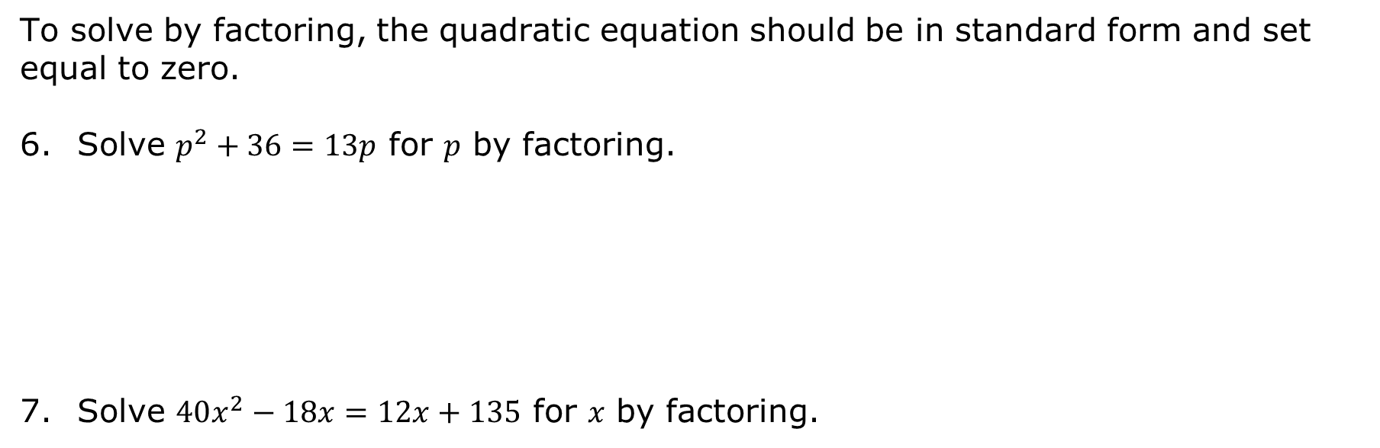
To solve by factoring, the quadratic equation should be in standard form and set equal to zero.
Solve $p^{2}+36=13p$ for 𝑝 by factoring.
Solve $40x^{2}−18x=12x+135$ for 𝑥 by factoring.
volume 2, pg. 96

Slide 18

Try It
volume 2, pg. 97

Slide 19
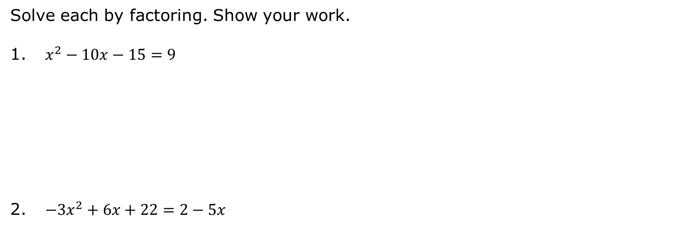
9.7.4 Try It: Factoring
Solve each by factoring. Show your work.
$x^{2}−10x−15=9$
$−3x^{2}+6x+22=2−5x$
volume 2, pg. 97

Slide 20

Wrap-Up
volume 2, pg. 97

Slide 21

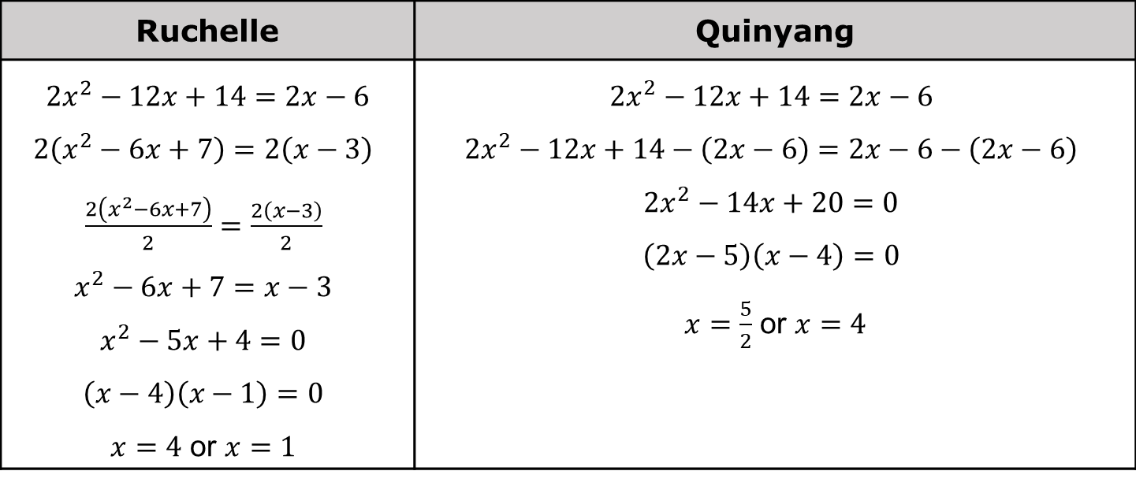
9.7.5 Wrap-Up: Error Analysis
The work of two students who solved $2x^{2}−12x+14=2x−6$ is shown.
Both Ruchelle and Quinyang made one mistake. Circle each mistake.
Ruchelle | Quinyang
$$2x^{2}−12x+14=2x−6$$ $2\left(x^{2}−6x+7\right)=2\left(x−3\right)$ $\frac{2\left(x^{2}−6x+7\right)}{2}=\frac{2\left(x−3\right)}{2}$ $x^{2}−6x+7=x−3$ $x^{2}−5x+4=0$ $\left(x−4\right)\left(x−1\right)=0$ $x=4$ or $x=1$ | $2x^{2}−12x+14=2x−6$ $2x^{2}−12x+14−\left(2x−6\right)=2x−6−\left(2x−6\right)$ $2x^{2}−14x+20=0$ $\left(2x−5\right)\left(x−4\right)=0$ $x=\frac{5}{2}$ or $x=4$
volume 2, pg. 97

